Slide 1

Objectives
In this session, you will learn to:
  Create and alter accounting vouchers
Notes:
Share the session objectives with the students.

Slide 2
Identifying Accounting Vouchers
In accounting terms, a voucher:
  Is a document containing the details of a financial transaction.
  Is used to enter the details into the ledgers to update the financial position of the company.
In Tally.ERP 9, vouchers are categorised into the following types:
  Accounting Vouchers
  Inventory Vouchers

Slide 3
Identifying Accounting Vouchers (Contd.)
Tally.ERP 9 is pre-programmed with the following standard accounting vouchers:
  Contra voucher (F4)
  Payment voucher (F5)
  Receipt voucher (F6)
  Journal voucher (F7)
  Sales voucher /Invoice (F8)
  Credit note voucher (CTRL+ F8)
  Purchase voucher (F9)
  Debit note voucher (CTRL+ F9)
  Reversing journals (F10)
  Memo voucher (CTRL+ F10)

Slide 4
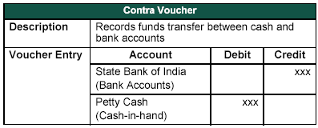
Identifying Accounting Vouchers (Contd.)
Contra voucher (F4):
  Contains transaction indicating transfer of funds from:
    Cash account to Bank account
    Bank account to Cash account
    One Bank account to another Bank account
  The following figure shows the sample entry of a contra voucher being used while withdrawing money from the bank for petty cash.

Slide 5

Identifying Accounting Vouchers (Contd.)
Let us see how to use a contra voucher to record the entry.
Notes:
You need to perform the steps given under the following topic:
5.1.1 Contra Voucher (F4) (page 84)

Slide 6

Identifying Accounting Vouchers (Contd.)
When can we use a payment voucher?

Slide 7
Identifying Accounting Vouchers (Contd.)
We can use the payment voucher to record all the payments made by cash and through bank.
Notes:
You need to perform the steps given under the following topic:
5.1.2 Payment Voucher (F5) (page 85)

Slide 8
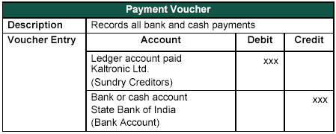
Identifying Accounting Vouchers (Contd.)
Payment voucher (F5):
  The following figure shows the sample entry of a payment voucher being used while a company is settling a creditor’s bill by cheque.

Slide 9
Identifying Accounting Vouchers (Contd.)
Let us see how to use a payment voucher to record the entry.
Notes:
You need to perform the steps given under the following topic:
5.1.2 Payment Voucher (F5) (page 87)

Slide 10
Identifying Accounting Vouchers (Contd.)
Let us see how to make a payment in single entry mode.
Notes:
You need to perform the steps given under the following topic:
5.1.2 Payment Voucher (F5) (page 88)

Slide 11
Identifying Accounting Vouchers (Contd.)
Advantages of a single entry mode:
  Multiple debits or credits can be selected depending on the type of entry.
  The transactions can be recorded in single entry mode even in Receipt and Contra vouchers.
  Warn on Negative Cash Balance:
  If the cash balance is NIL, a warning is displayed when Warn on Negative Cash Balance is set to Yes in the F12: Payment Configuration.

Slide 12
Identifying Accounting Vouchers (Contd.)
When can we use a receipt voucher?

Slide 13
Identifying Accounting Vouchers (Contd.)
We can use the receipt voucher to record all the transactions involving receipt of cash and through bank.

Slide 14
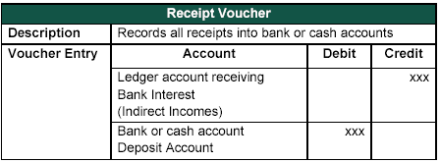
Identifying Accounting Vouchers (Contd.)
Receipt voucher (F6):
  The following figure shows the sample entry of a receipt voucher used in case a company receives a bank advice that the interest has been credited to its deposit account.

Slide 15
Identifying Accounting Vouchers (Contd.)
Let us see how to use a receipt voucher to record the entry.
Notes:
You need to perform the steps given under the following topic:
5.1.3 Receipt Voucher (F6) (page 91)

Slide 16
Identifying Accounting Vouchers (Contd.)
When can we use a journal voucher?

Slide 17
Identifying Accounting Vouchers (Contd.)
We can use the journal voucher to record the adjustment entries, to adjust the debit and credit amounts without
involving cash or bank accounts.
Notes:
You need to perform the steps given under the following topic:
5.1.4 Journal Voucher (F7) (page 90)

Slide 18
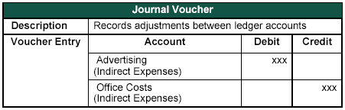
Identifying Accounting Vouchers (Contd.)
Journal voucher (F7):
  The following figure shows the sample entry of a journal voucher used in case a company has entered some expenditure on advertising as general office costs, rather than recording the transaction in the separate ledger for advertising.

Slide 19
Identifying Accounting Vouchers (Contd.)
Let us see how to use a journal voucher to record the entry.
Notes:
You need to perform the steps given under the following topic:
5.1.4 Journal Voucher (F7) (page 92)

Slide 20
Identifying Accounting Vouchers (Contd.)
When can we use a sales voucher?

Slide 21
Identifying Accounting Vouchers (Contd.)
We can use the sales voucher when the company sells some goods to the customers either by cash, cheque or on credit basis.

Slide 22
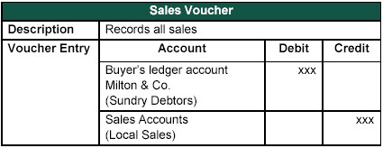
Identifying Accounting Vouchers (Contd.)
Sales voucher (F8):
  The following figure shows the sample entry of a sales voucher used when a company sells software on credit.

Slide 23
Identifying Accounting Vouchers (Contd.)
Let us see how to use a sales voucher to record the entry.
Notes:
You need to perform the steps given under the following topic:
5.1.5 Sales Voucher (F8) (page 94)

Slide 24
Identifying Accounting Vouchers (Contd.)
When can we use a credit note voucher?

Slide 25
Identifying Accounting Vouchers (Contd.)
We can use the credit note voucher to record credit note entry for sales return or customer overcharging.

Slide 26
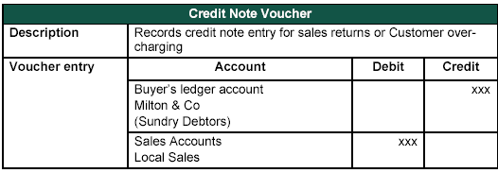
Identifying Accounting Vouchers (Contd.)
Credit note voucher (Ctrl + F8):
  The following figure shows the sample entry of a credit note voucher used when a customer returns stock that was incorrectly supplied.

Slide 27
Identifying Accounting Vouchers (Contd.)
Let us see how to use a credit note voucher to record the entry.
Notes:
You need to perform the steps given under the following topic:
5.1.6 Credit Note Voucher (Ctrl + F8) (page 95)

Slide 28
Identifying Accounting Vouchers (Contd.)
When can we use a purchase voucher?

Slide 29
Identifying Accounting Vouchers (Contd.)
We can use the purchase voucher when the company purchases some goods from the customers either
by cash, cheque or on credit basis.

Slide 30
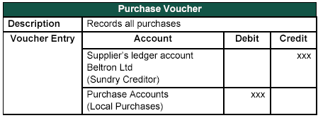
Identifying Accounting Vouchers (Contd.)
Purchase voucher (F9):
  The following figure shows the sample entry of a purchase voucher used when a company buys computer parts on credit.

Slide 31
Identifying Accounting Vouchers (Contd.)
Let us see how to use a purchase voucher to record the entry.
Notes:
You need to perform the steps given under the following topic:
5.1.7 Purchase Voucher (F9) (page 97)

Slide 32
Identifying Accounting Vouchers (Contd.)
When can we use a debit note voucher?

Slide 33
Identifying Accounting Vouchers (Contd.)
The Debit note voucher is commonly used in case of purchase returns or supplier over charging.

Slide 34
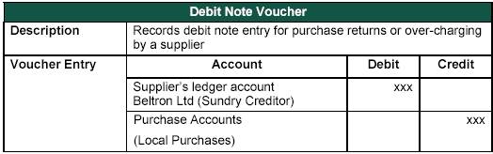
Identifying Accounting Vouchers (Contd.)
Debit note voucher (Ctrl + F9):
  The following figure shows the sample entry of a debit note voucher used when a company returns damaged goods to a supplier.

Slide 35
Identifying Accounting Vouchers (Contd.)
Let us see how to use a debit
note voucher to record
the entry.
Notes:
You need to perform the steps given under the following topic:
5.1.8 Debit Note Voucher (Ctrl + F9) (page 98)

Slide 36
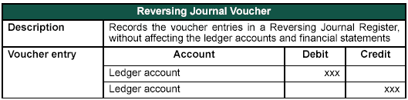
Identifying Accounting Vouchers (Contd.)
Reversing journal voucher (F10):
  Is a special journal that automatically reversed after the date of the journal.
  Exists only for a day and are effective on the date of the reversing journal.
  Is useful in scenario management.
The following figure shows the sample entry for a reversing journal voucher.

Slide 37
Identifying Accounting Vouchers (Contd.)
How can we enable the F10: Rev Jrnl button?

Slide 38
Identifying Accounting Vouchers (Contd.)
To enable the F10: Rev Jrnl button, you need to perform the following tasks:
Go Gateway of Tally > F11:Features>Accounting Features> Set the Use Reversing Journal and Optional Vouchers to YES.

Slide 39
Identifying Accounting Vouchers (Contd.)
Let us see how to use a
reversing journal voucher
to record the entry.
Notes:
You need to perform the steps given under the following topic:
5.1.9 Reversing Journal Voucher (F10) (page 94)

Slide 40
Identifying Accounting Vouchers (Contd.)
Memo voucher (Ctrl + F10):
  It is a non-accounting voucher and the entries made using it does not affect the customer’s accounts.
  It is used for the following purposes:
    Making suspense payments.
    Verifying vouchers not verified at the time of entry.
    Tracking and converting items given on approval into proper sales voucher.

Slide 41
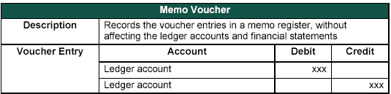
Identifying Accounting Vouchers (Contd.)
Memo voucher (Ctrl + F10):
  The following figure shows the sample entry of a memo voucher.
Notes:
Share the session objectives with the students.

Slide 42
Summary
In this session, you learned that:
  A voucher is a document containing the details of a financial transaction.
  As per accounting rules, any transaction indicating the transfer of funds from cash account to bank account; bank account to cash account and bank account to bank account is referred to as a Contra Entry.
  Reversing Journals are special journals that are automatically reversed after the date of the journal.
  A Memo Register is a non-accounting voucher and the entries made using it will not affect your accounts.

